Slide 1
Why My Code Summarization Model Does Not Work: Code Comment Improvement with Category Prediction
QIUYUAN CHEN, College of Computer Science and Technology, Zhejiang University XIN XIA and HAN HU, Faculty of Information Technology, Monash University, Victoria, Australia DAVID LO, School of Information Systems, Singapore Management University, Singapore SHANPING LI, College of Computer Science and Technology, Zhejiang University
TOSEM 2021

Slide 2
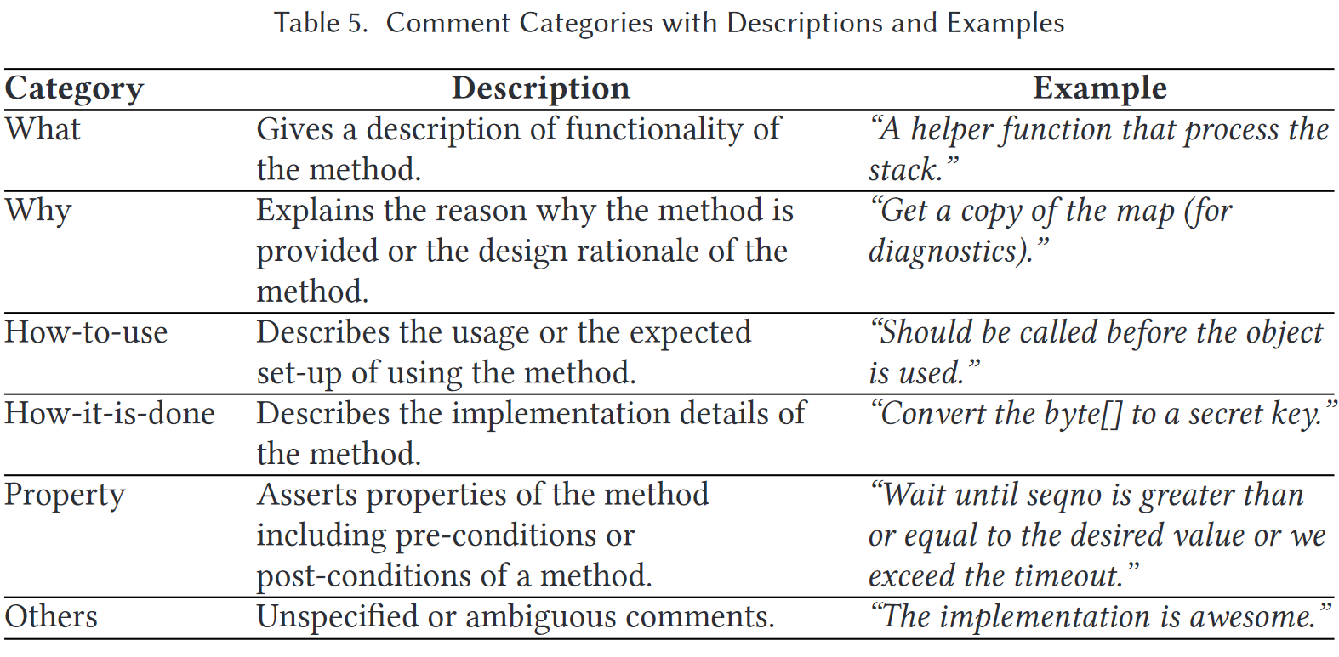
Comment Categories
Comments are not all written for the same purpose: they are in different categories (categories used here come from [1]).

Slide 3
Research Questions
How do different comment categories impact the code summarization performance?
6 SOTA models are trained on the whole dataset and evaluated in each category. We found that difference between each category is significant, and that no model dominates in all categories.
How can we improve the code summarization performance using the comment categories?
Build a classifier to predict comment category from code and use the best model for that particular category.

Slide 4
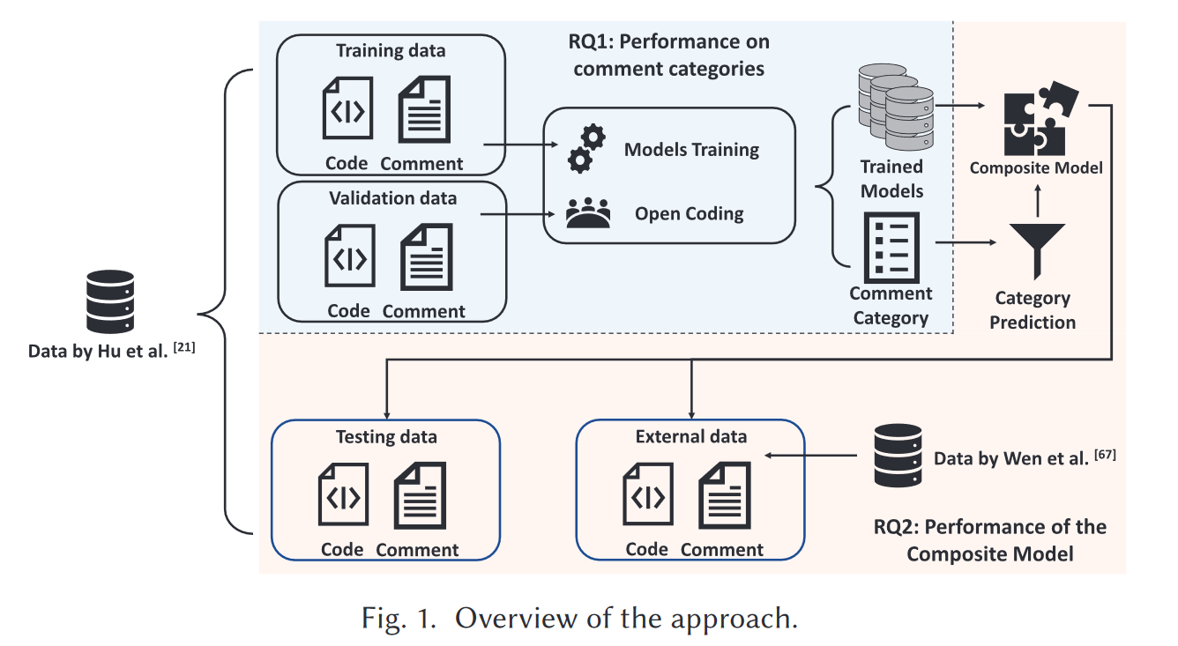
Approach Overview

Slide 5
Dataset
Training, validation, testing data come from Hu et al [2].
No overlap between each set.
External data come from Wen et al [3].
Random subset that is of the same size as the testing dataset.
Training data: train code summarization models.
Validation data: validate model performance and train the classifier.
Testing & external data: evaluate the final composite model.

Slide 6
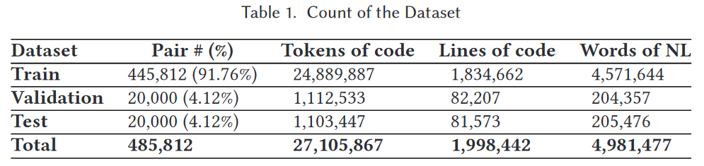
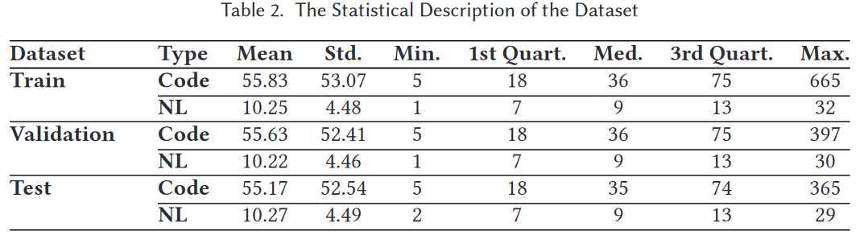
Dataset Statistics

Slide 7
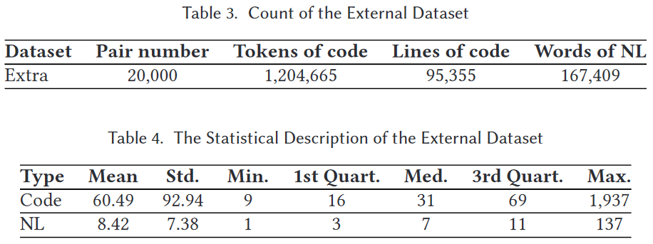
Dataset Statistics

Slide 8
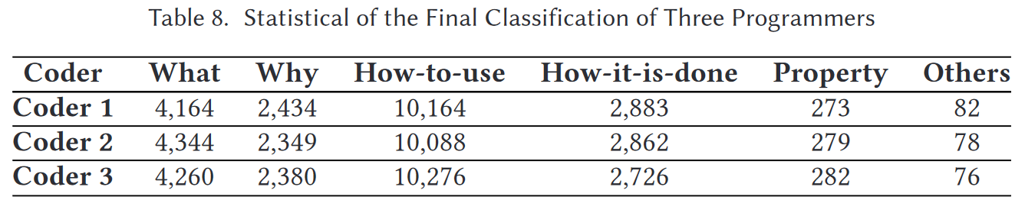
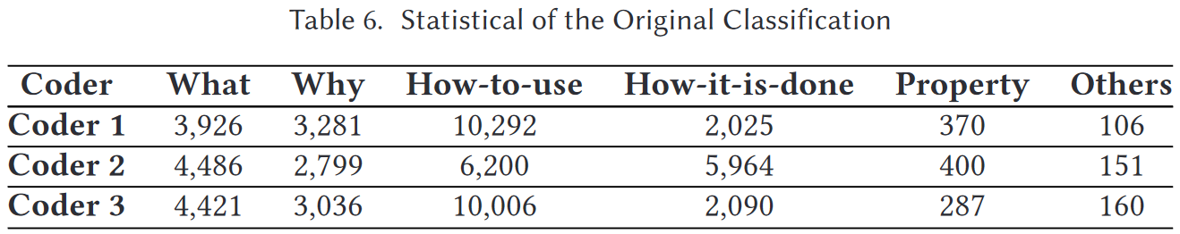
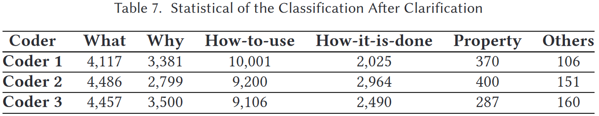
Category Classifying
Three volunteers on validation dataset:
Individual classification.
Discuss and merge conflict.
Iterate and revisit.

Slide 9
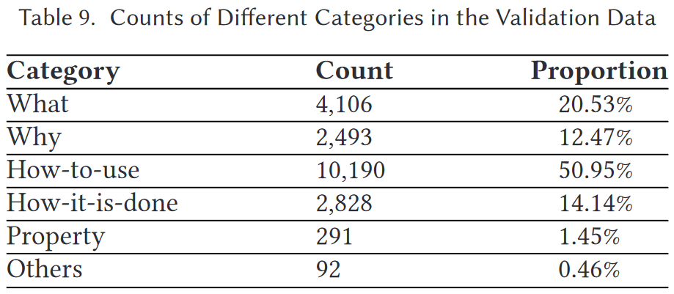
Category Statistics

Slide 10
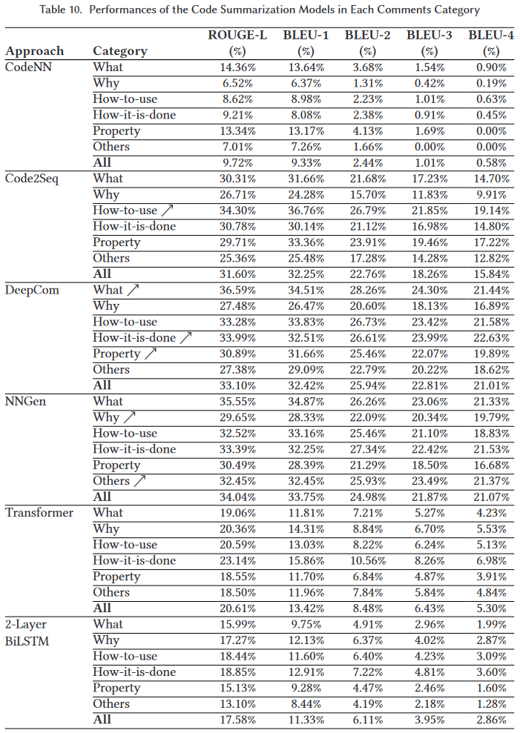
Model Performances
↗: significantly best in category.

Slide 11
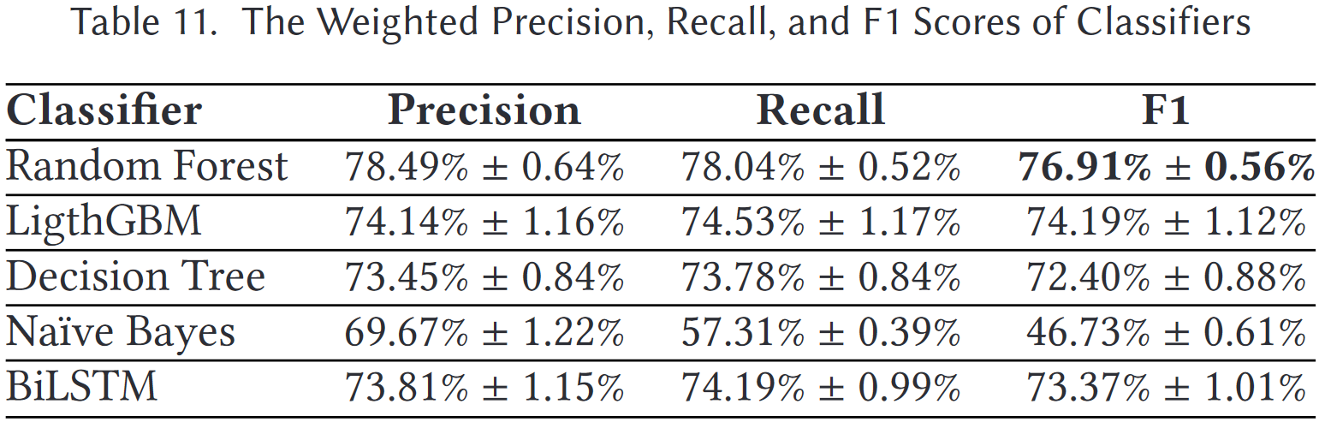
Category Classifier
Accuracy in 10-fold cross-validation on validation data.

Slide 12
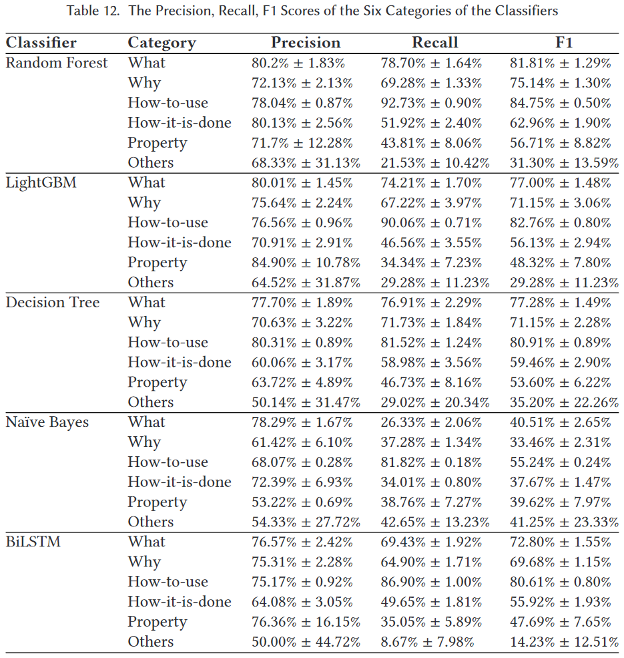
Category Classifier Statistics per Category

Slide 13
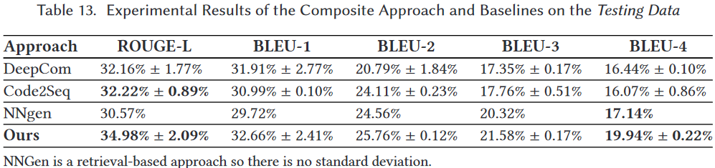
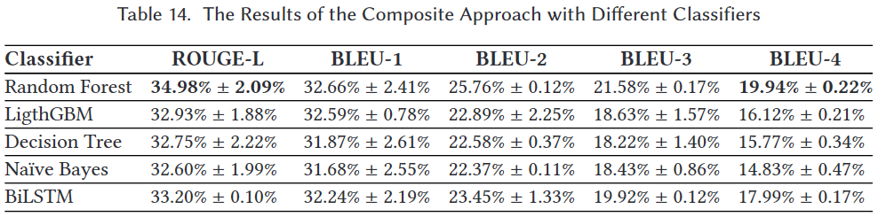
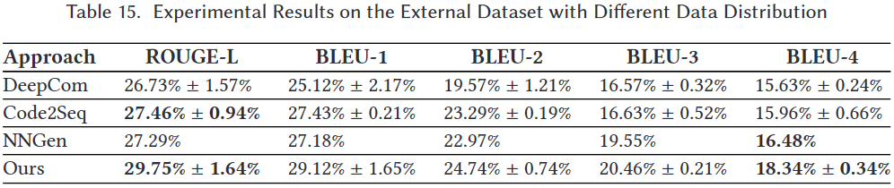
Experimental Results

Slide 14
Conclusion
Comments have categories, which should be considered.
Different summarization models fit different categories of comments.
Mixing models based on categories of comments may be beneficial.

Slide 15
References
[1] CPC: Automatically classifying and propagating natural language comments via program analysis (ICSE 2020).
[2] Deep code comment generation with hybrid lexical and syntactical information (ESE 2019).
[3] large-scale empirical study on code-comment inconsistencies (ICPC 2019).

